Slide 1

WEATHER MONITOR
IOT SYSTEM FOR HVAC OPTIMIZATION
December - 2024
Abu Taher, Mufrad Mahmud, Md. Noman, Tanmoy Chowdhury

Slide 2
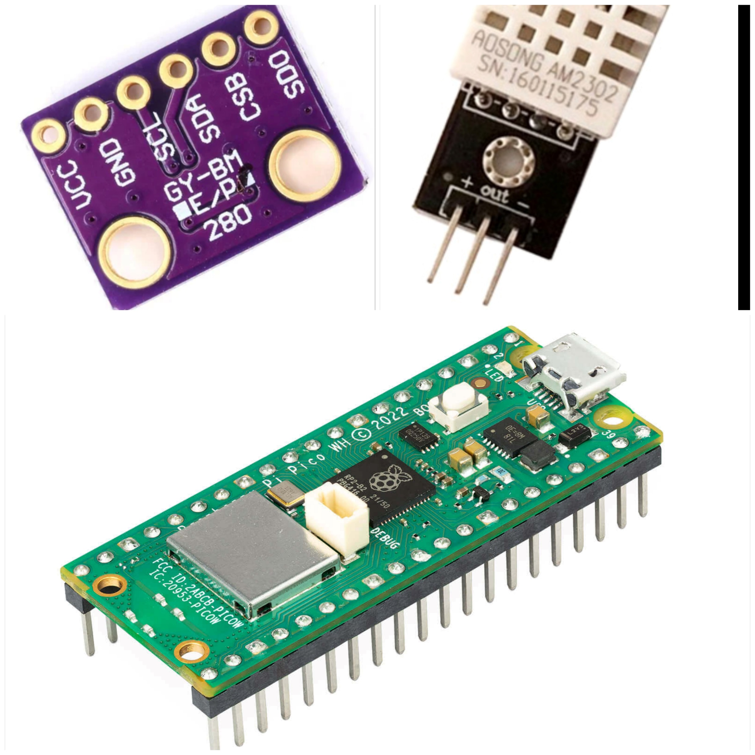

System Components
BMP280 Sensor
DHT22 Sensor
Measures temperature and pressure, ideal for precise environmental data.
Suitable for reading humidity and temperature and also got high reliability capability.
Raspberry Pi Pico W
A compact microcontroller that integrates IoT capabilities, enabling remote data processing.

Slide 3

IOT SYSTEM FOR HVAC OPTIMIZATION
Data Management
InfluxDB
Time-Series Database: Optimized for sensor data like temperature, pressure, and humidity. | High Performance: Handles frequent updates (10s intervals) efficiently. | Real-Time Queries: Enables live monitoring and quick analysis.
Retention Policies: Manages old data automatically to save storage. | Scalable: Adapts easily to growing IoT devices and data volumes. | Integration: Works seamlessly with MQTT, Grafana for visualization.
 | Edge Processing: Supports local deployments for low latency and reliability.

Slide 4

Predictive Modeling
Model Overview
We employ machine learning to analyze occupancy patterns, optimizing HVAC performance and conserving energy.
Our Approach:
K-Means Clustering: Identify patterns in room usage.
Data Handling: Collect normal/abnormal data, merge, and extract features.
Model Training: Train predictive models and integrate for real-time usage. Used Random forest model (size: 78kb) for classification purpose, predict whether the room is being used normally or abnormally.

Slide 5

User-Friendly App
IOT SYSTEM FOR HVAC OPTIMIZATION
User Interface Design
Simple design prioritizing user experience, overlaying data with intuitive navigation.
App Features
Provide real-time monitoring, remote control of HVAC systems, and user notifications.

Slide 6
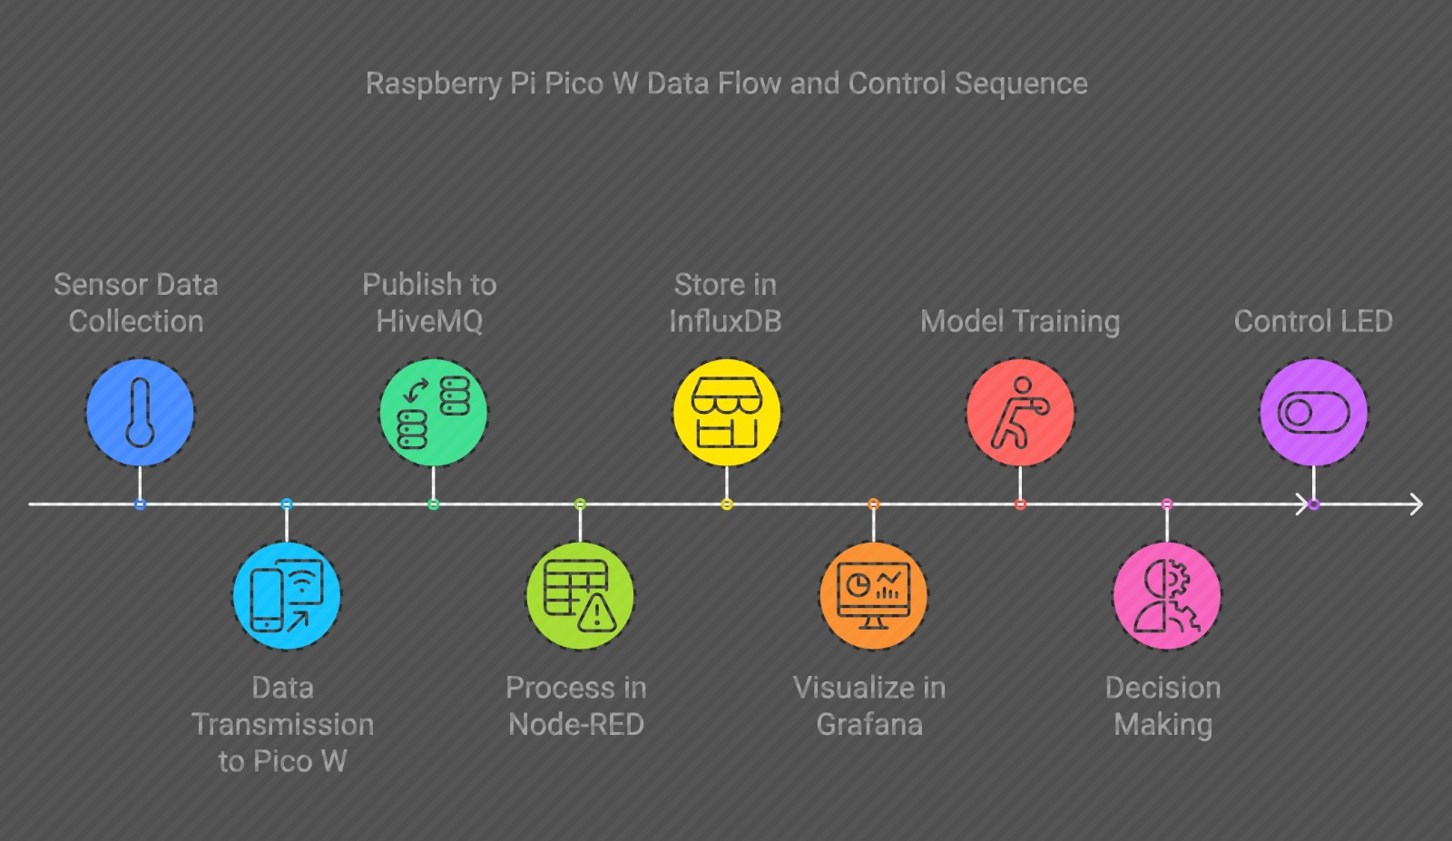
Action Flow

Slide 7
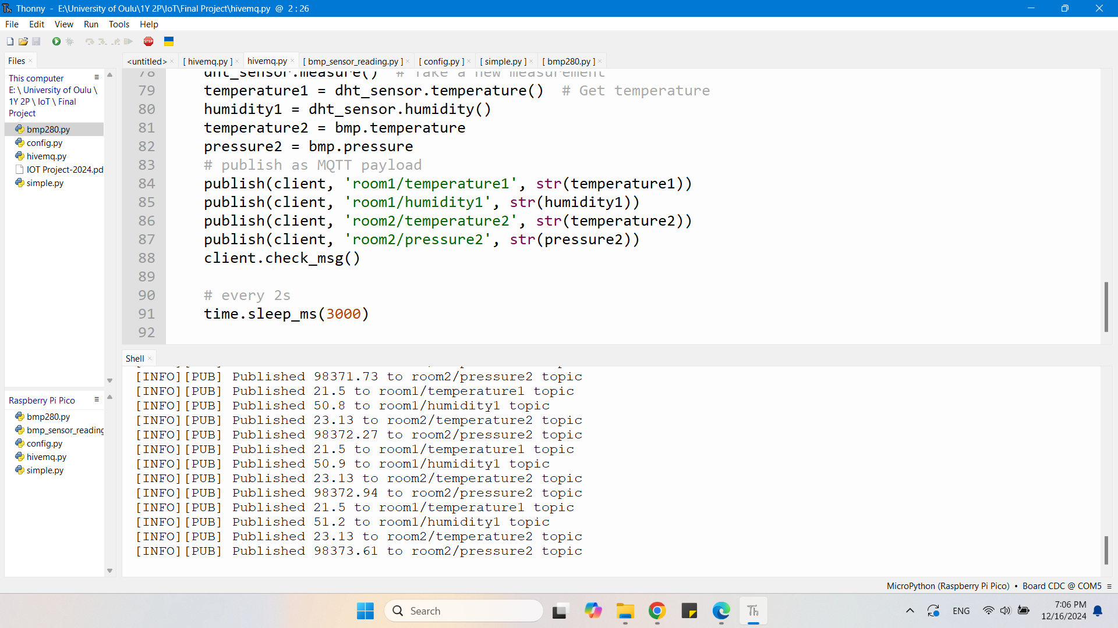
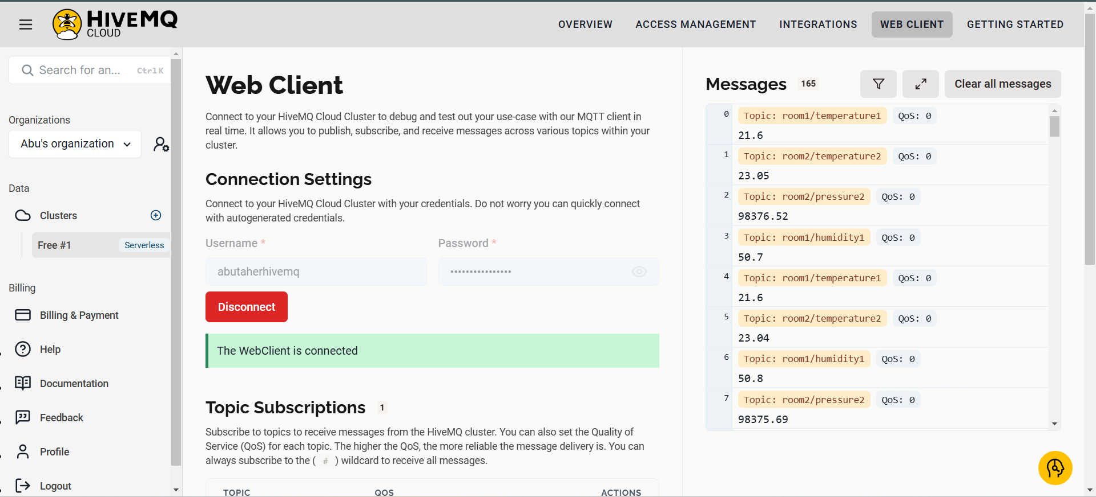

IOT SYSTEM FOR HVAC OPTIMIZATION
Results & Insights

Slide 8
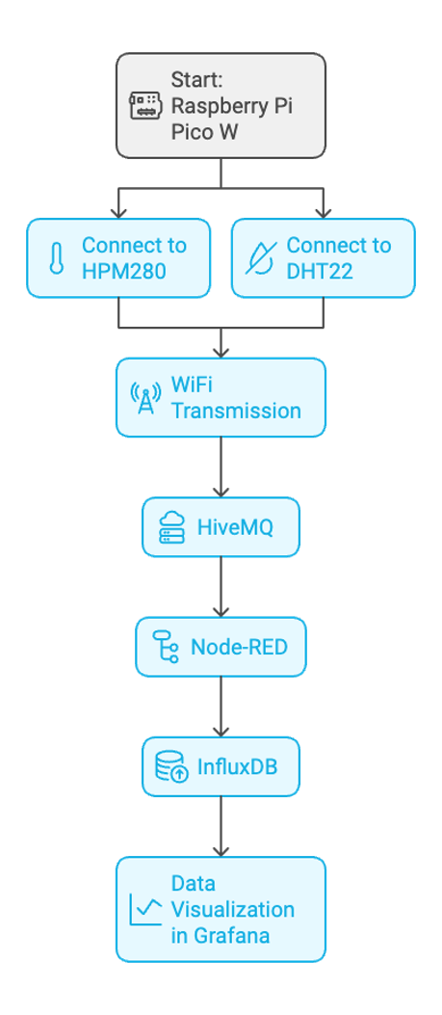
​

Slide 9
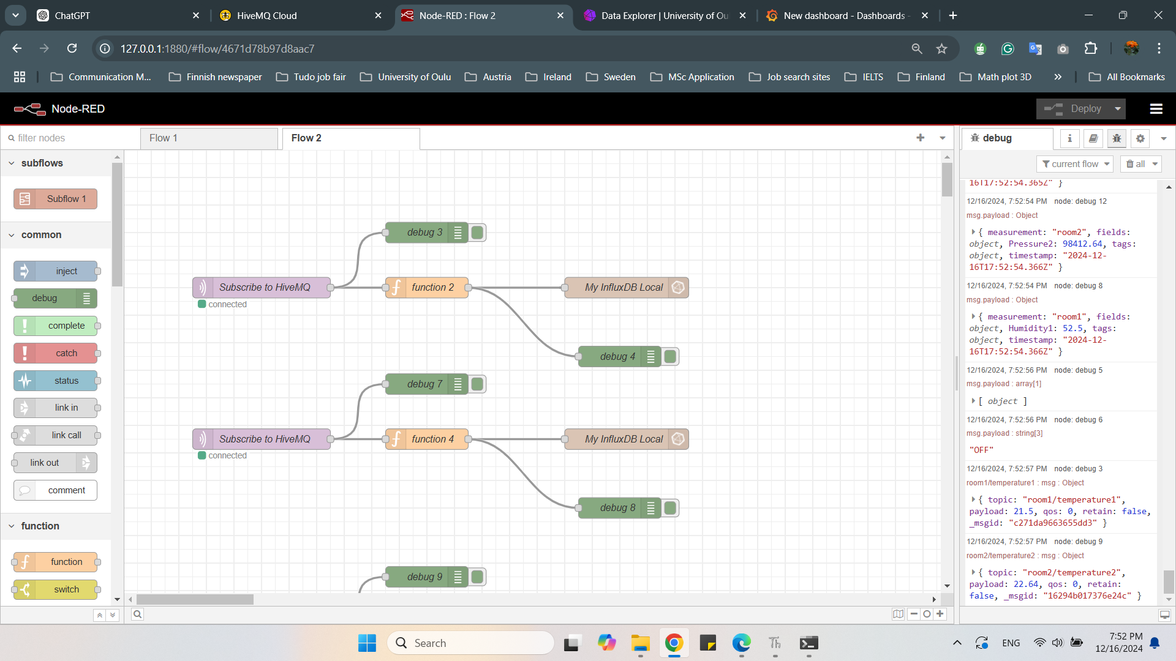
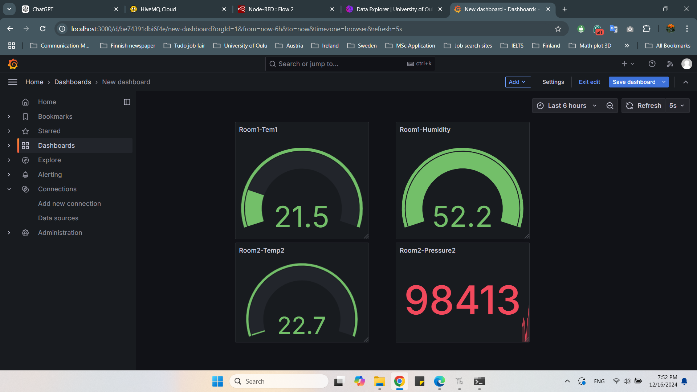
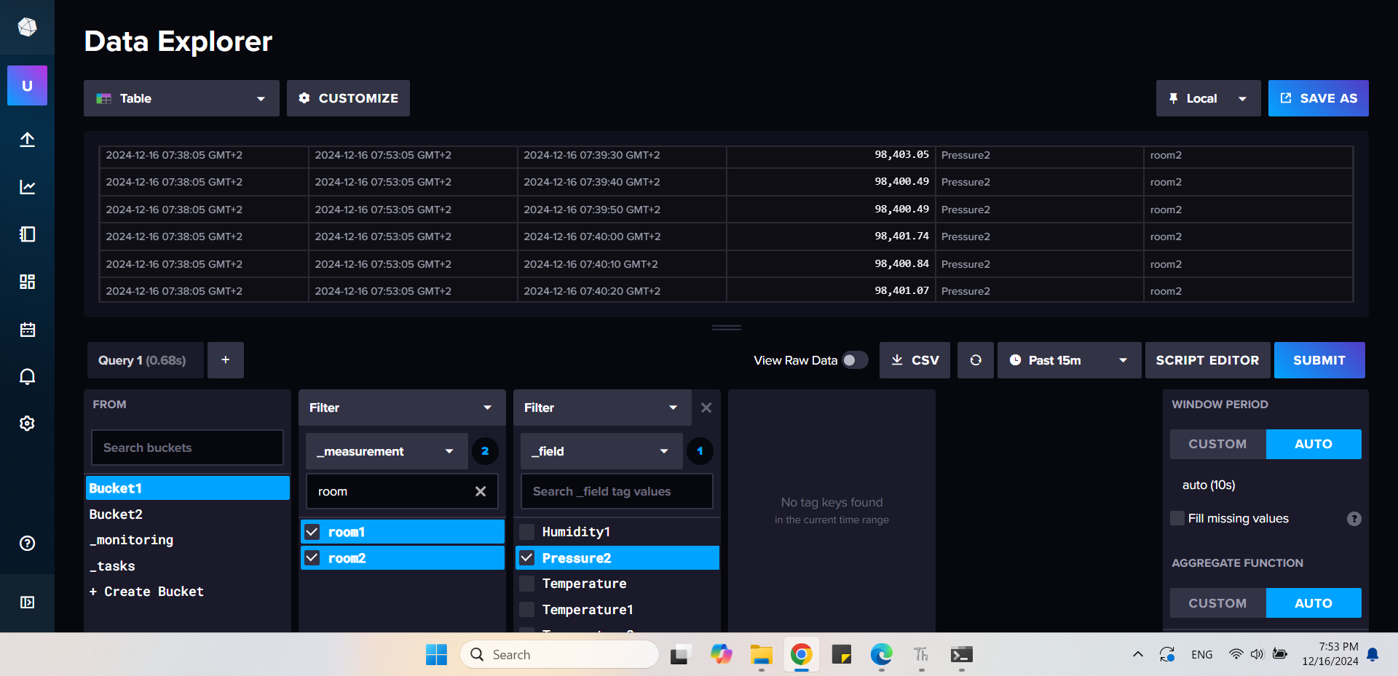
Results & Insights (continued…)

Slide 10
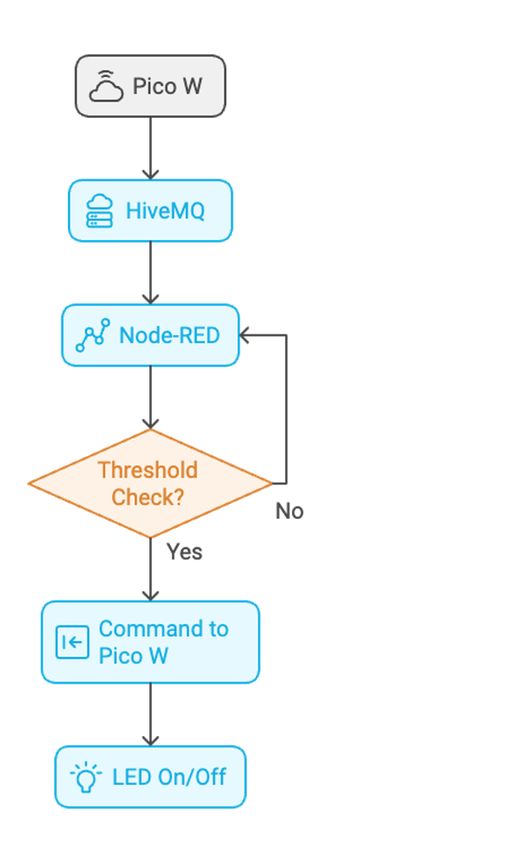
IOT SYSTEM FOR HVAC OPTIMIZATION
Results & Insights (continued…)

Slide 11
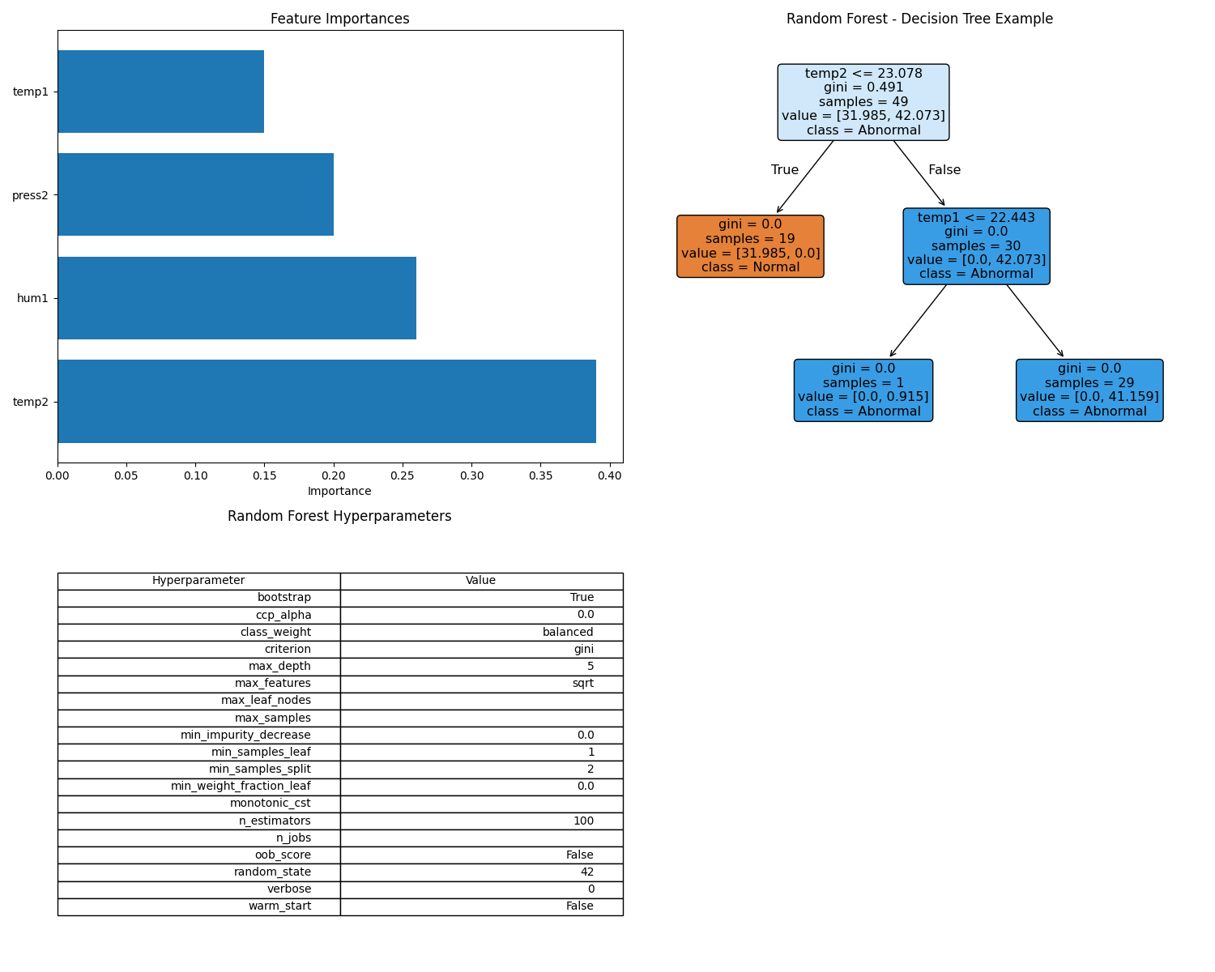
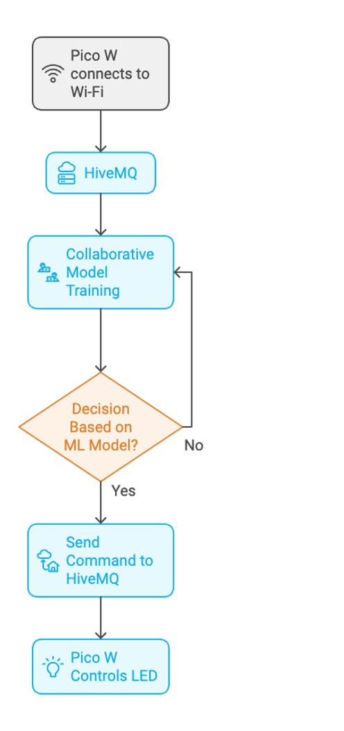
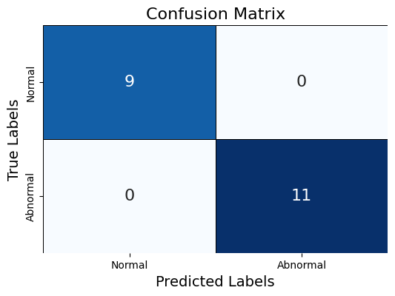
Results & Insights (continued…)

Slide 12


